Slide 1
COVID19 EDA - Trends and Outbreak Prediction of Spread in USA
Student Name : Ragunath Gunasekaran
Professor Name : Dr. Shankar Parajulee
Course Name : Data Exploration and Analysis

Slide 2
Variables in Dataset
Date is the object data type when the event occurred ( death / confirmed case )
Cases is the integer of number of confirmed COVID cases
Deaths is the integer of number of death count
State is object data type of the US State where the event occurred
Fips is the integer of geographic areas.
County is object data type of the US County where the event occurred
DeathRate is the integer of number deaths divided by Number confirmed Cases

Slide 3
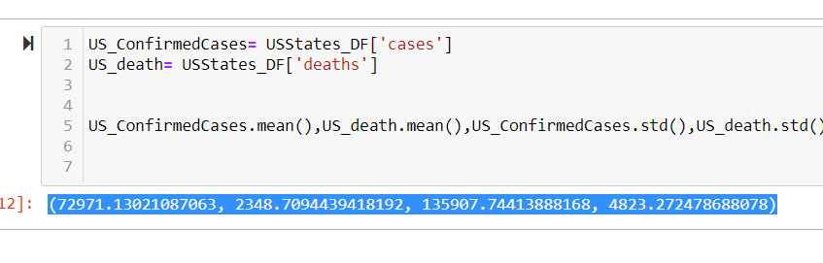
Mean, Standard Deviation in the dataset

Slide 4
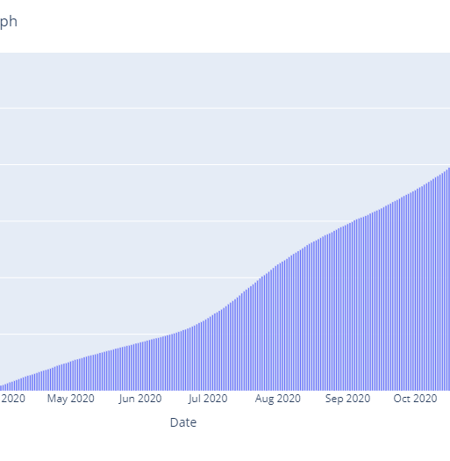
US COVID Active Cases Graph

Slide 5
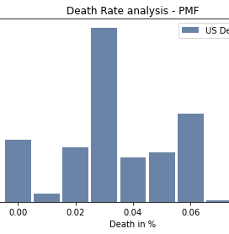
Histogram of Variables

Slide 6
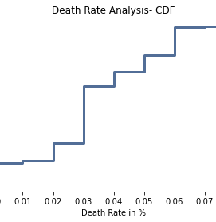
Cumulative distribution function

Slide 7
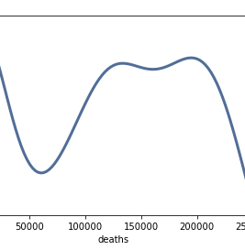
PDF (probability density function)

Slide 8
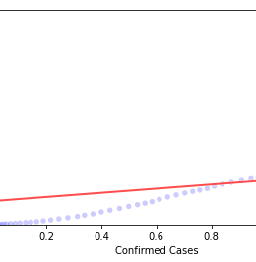
Confirmed vs Death cases with the Fitted line - Slope

Slide 9
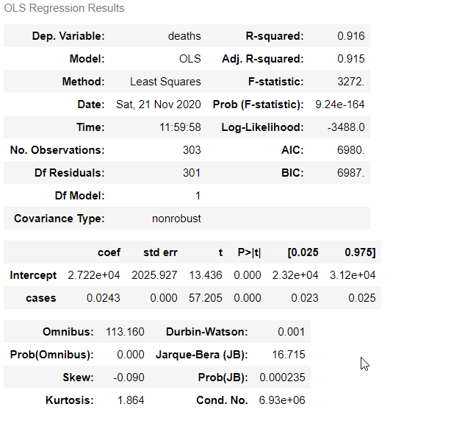
Linear Regression - Death vs Cases

Slide 10
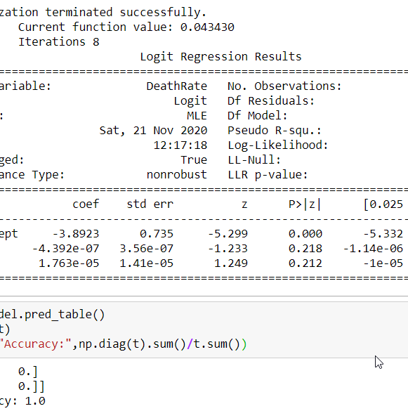
Logistic Regression - Death Rate with Confirmed, Death Cases

Slide 11
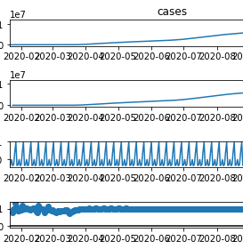
ETS ( Error, Trend, and Seasonality )

Slide 12
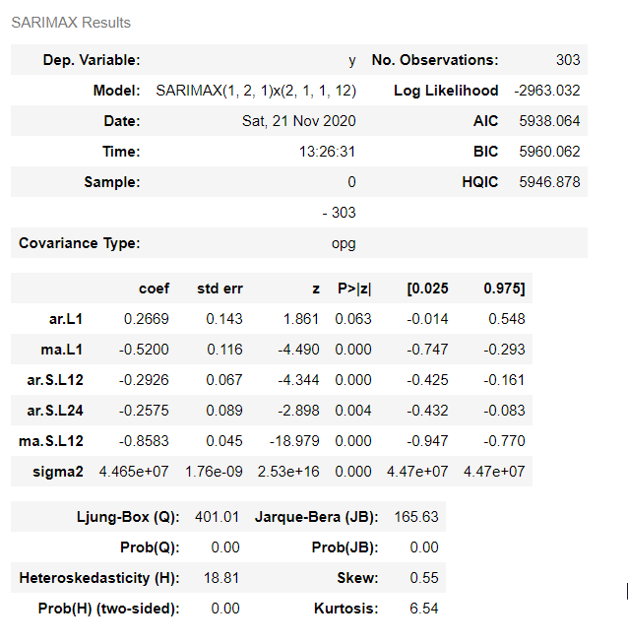
Forecast using ARIMA Model

Slide 13
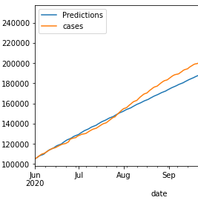
Forecast Comparison (training dataset up to June 2020)

Slide 14

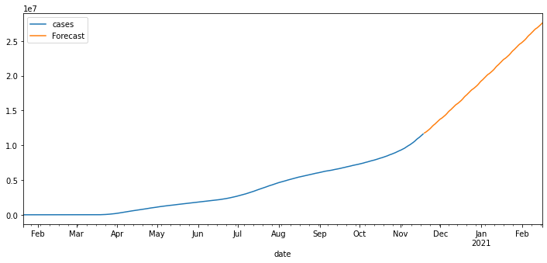
Time Series (Prediction – confirmed Cases)

Slide 15
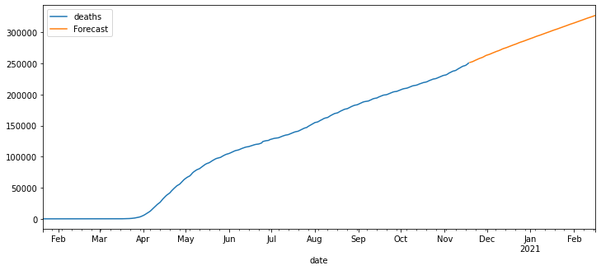
Time Series (Prediction – death Count)

